Slide 1
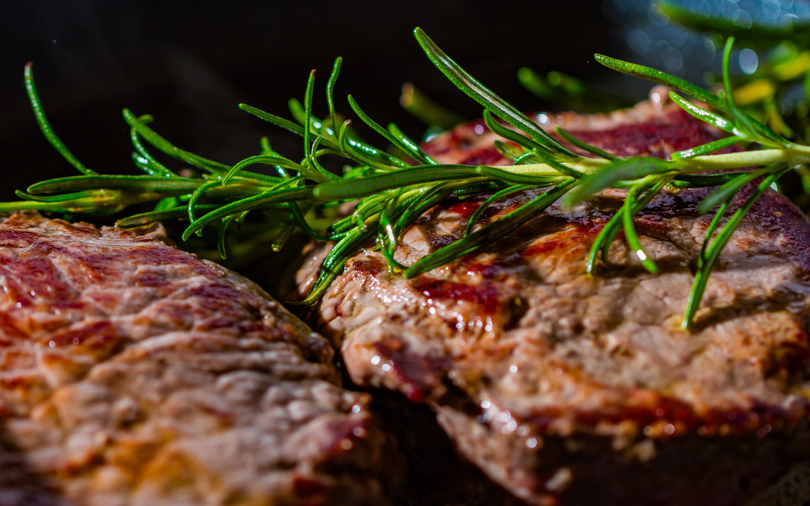





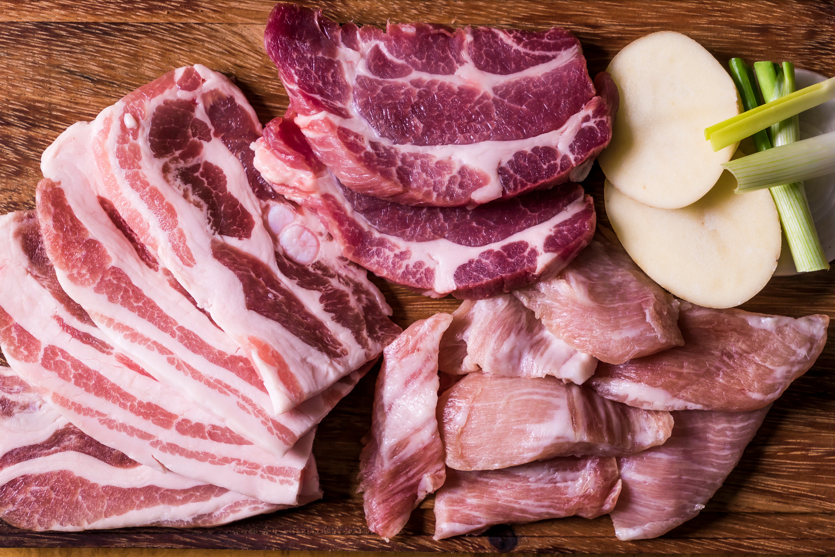
Meat Price Predictions between Pork and Beef utilizing USDA Data
Trisha Winquist
1/11/2025
Bellevue University

Slide 2



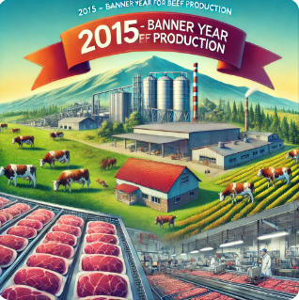

Bussiness Problem
To analyze the pricing structure of agricultural products and identify inefficiencies, price drivers, and trends in order to:
Improve price transparency across the supply chain.
Enable data-driven pricing strategies for producers, wholesalers, and retailers.
Support policy decisions related to agricultural subsidies, price regulations, and consumer protection.
2015 was a banner year for beef production. What happened?

Slide 3
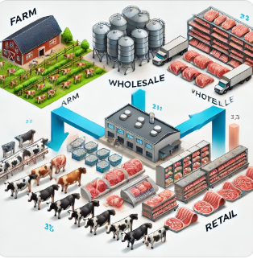

The Importance of Data Analysis in the meat Industry
In today's data-driven world, data analysis is crucial for success. It enables organizations to gain valuable insights, reduce risks, improve efficiency, and understand customer behavior, resulting in more effective strategies. In the meat industry, data analysis is indispensable for driving operational efficiencies, ensuring safety, meeting consumer demand, and maintaining ethical and environmental standards. As technologies like IoT (Internet of Things), machine learning, and big data continue to evolve, the role of data analysis in the meat industry will only increase, providing opportunities for further optimization and growth.

Slide 4
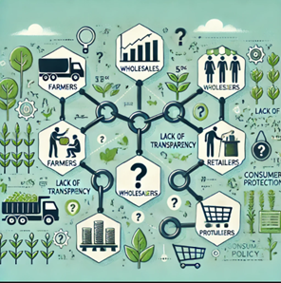
How Do Farm-level Prices influence Retail Prices?
The relationship between prices at the farm level and retail prices can be examined through statistical analysis, such as correlation and regression, to determine the extent of their influence. While farm-level prices are expected to have a direct impact on retail prices, this influence may be mediated by factors like wholesale costs, processing, transportation, and retailer markups.

Slide 5


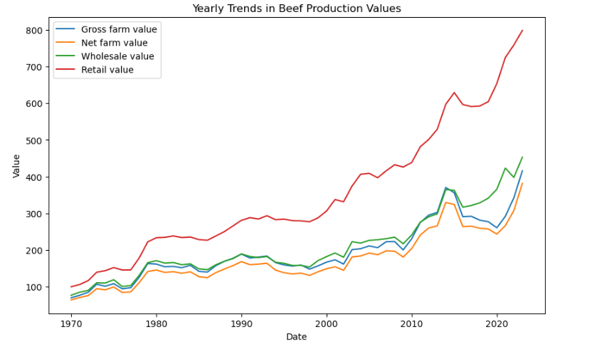
The Data Analysis
Beef Trends
Observations:
Upward Trend: All value categories (Gross Farm, Net Farm, Wholesale, Retail) exhibit a steady increase over time.
Retail Value: The retail value is consistently the highest, showing a significant gap compared to farm and wholesale values.
Parallel Movement: The trends of the categories largely move in parallel, suggesting interdependence between farm, wholesale, and retail pricing.

Slide 6

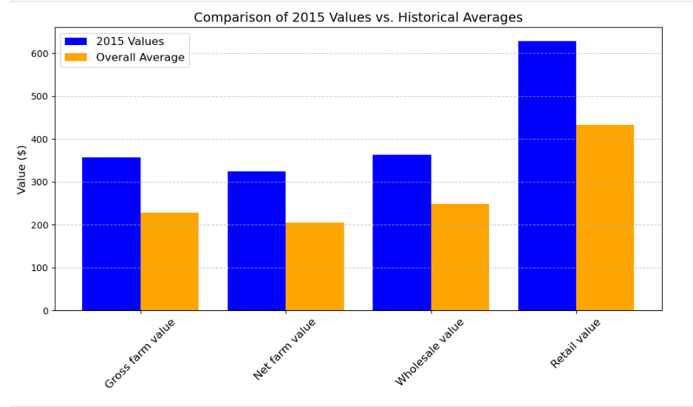
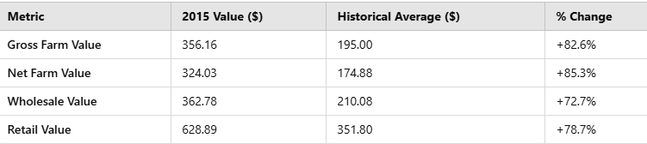
2015: A SIgnifigant Year for BeeF
Notable Peaks Across Metrics: Retail Value: $628.89, significantly higher than the historical average.
Wholesale Value: $362.78, a substantial increase compared to other years.
2015 was a landmark year for beef production trends, characterized by significant increases across all value metrics. The economic and market conditions of this year warrant deeper analysis to understand the drivers behind these record values.

Slide 7

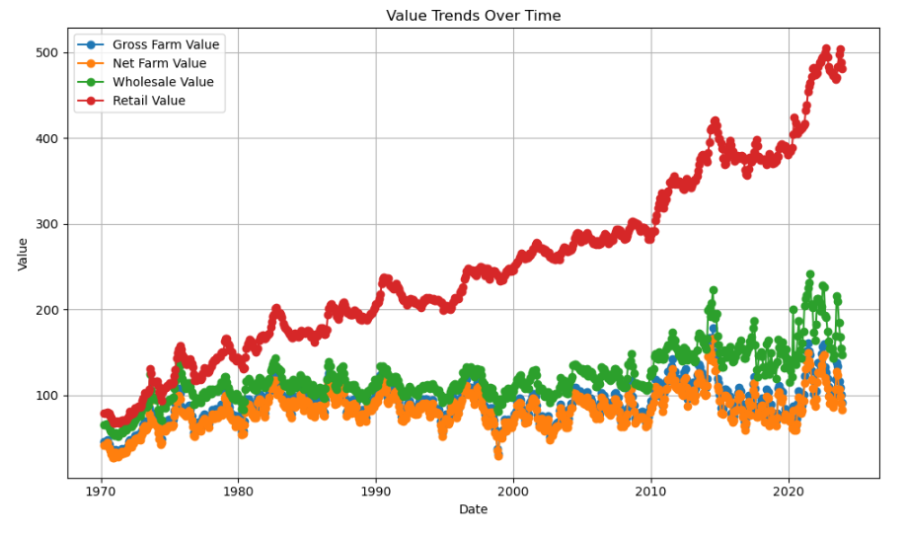
The Data Analysis
PORK Trends
2022 was a landmark year for the pork market, characterized by record-breaking retail values and significant growth across all production stages. These trends underscore the importance of understanding economic and market drivers behind this growth.

Slide 8

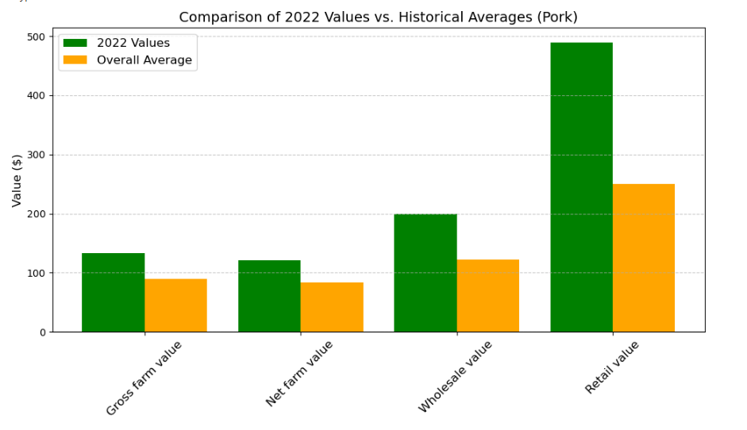
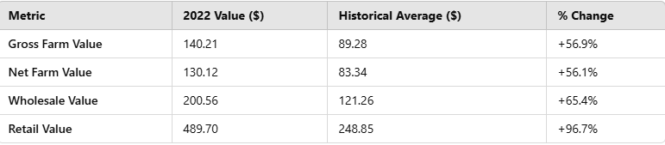
2022: A Notable Year for Pork Trends
Key Insights:
Remarkable Growth in Retail Value: Peaked at $489.70, marking the highest value on record.
This represents a 97% increase compared to the historical average of $248.85.

Slide 9

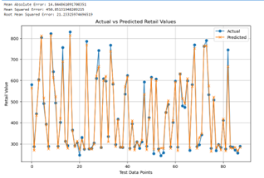

Analyzing Historical Trends & Predicting Future Values in Beef and Pork Supply Chains
Historical Analysis of Beef and Pork Supply Chain Values
Beef consistently exhibits higher values than pork, with pronounced fluctuations, especially in retail prices.
Retail price volatility in beef is influenced by higher production costs, consumer demand, and market dynamics.
Pork demonstrates steadier growth and smaller price margins across the supply chain.

Slide 10

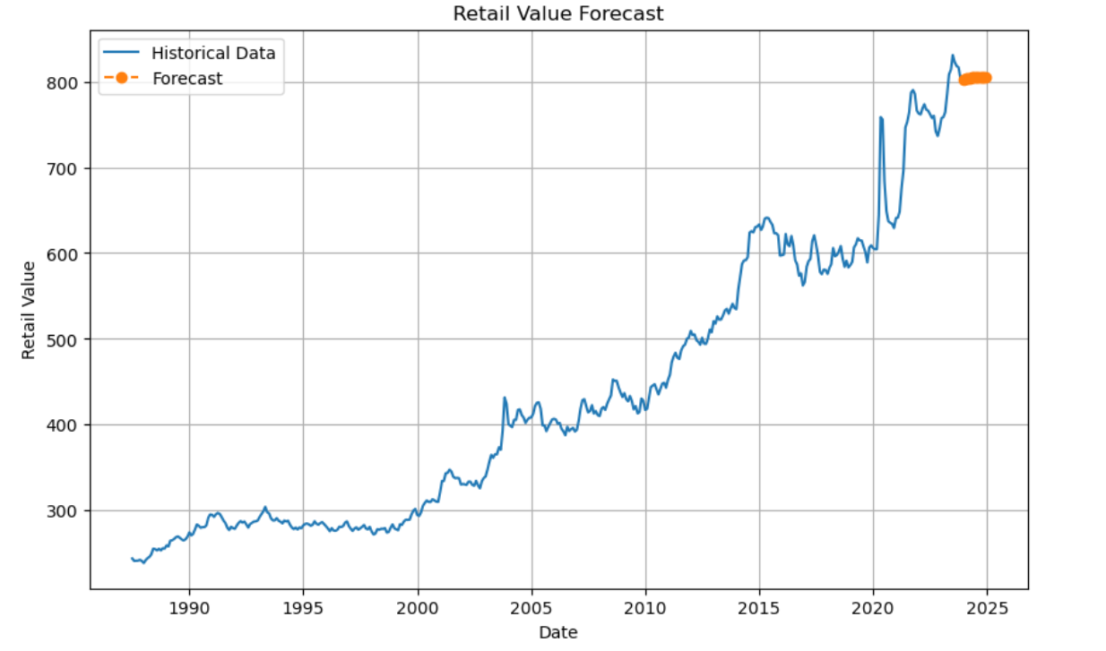
Predictive Modeling for Future Pricing
·Random Forest Regression and ARIMA time-series analysis were used to forecast future values.
·Key metrics analyzed include Gross Farm Value, Net Farm Value, Wholesale Value, and Retail Value.
·The models predict potential price trajectories and highlight influencing factors.

Slide 11
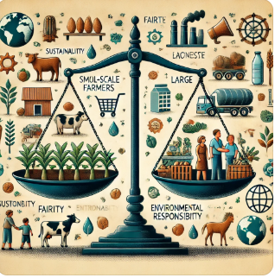
Ethical Considerations
"In conducting this analysis, we must consider ethical implications such as:
The impact of pricing transparency on small-scale farmers and large corporations.
The fairness of pricing structures to consumers.
The sustainability of meat production and its economic impact on rural communities."

Slide 12

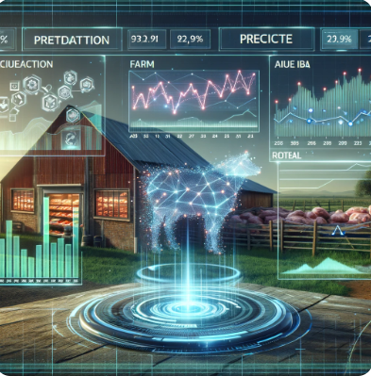
Conclusion
The Future of Data Analysis
Advancements in Data Science: Machine learning models and AI-driven analytics will enhance price prediction accuracy..
Market Volatility Considerations: Predictive analytics can help stakeholders anticipate disruptions from supply chain issues, inflation, and global trade policies.
-

